Slide 1
World’s Languages
Antonio Romano
LFSAG-Laboratorio di Fonetica Sperimentale «A. Genre»
General Linguistics (Foreign Languages Dept.), Speech Tech. (StudiUm), Glottology (Speech Therapy School) – Università di Torino
https://www.lfsag.unito.it/
Turin, 20 June 2023 - The Right to Education for All: The University Experience for International Students

Slide 2
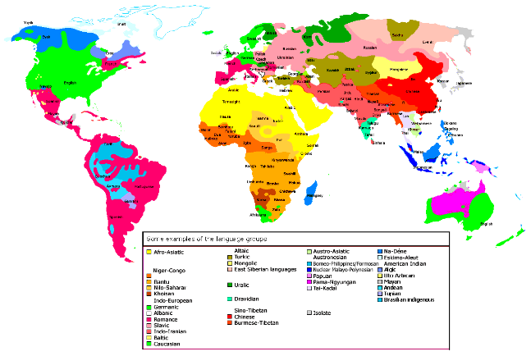
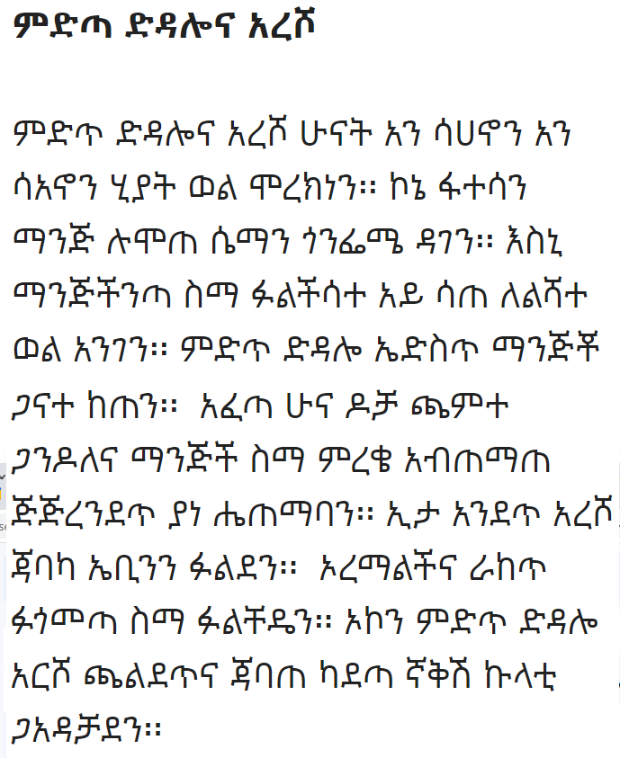
How many languages?
Thousands of unwritten/ unrecognised languages
Thousands of sounds
(The illusion of the alphabet and the writing systems)

Slide 3
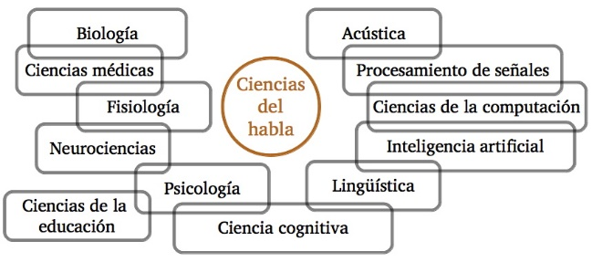
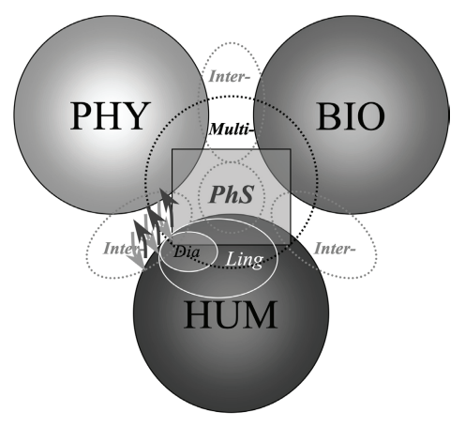
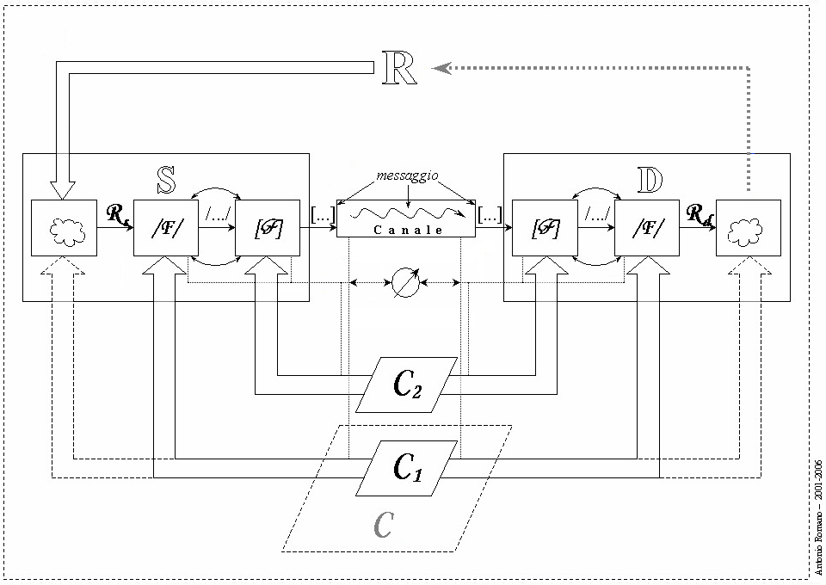
The interest for spoken language
joaquimllisterri.cat
Anthropology
Communications (Tele-, social)
Technologies (TTS, ASR...)
Arts (Singing, Theater, Poetry...)
Phoniatrics – Audiology
Forensic Linguistics
Historical Linguistics – Philology...
www.lfsag.unito.it/ricerca/phonews/02/2_1.pdf

Slide 4
Endangered languages
Language diversity and variation
Ecology of languages
Linguistic rights (Lois linguistiques: https://www.axl.cefan.ulaval.ca)
...
Minority languages
Under-resourced languages

Slide 5
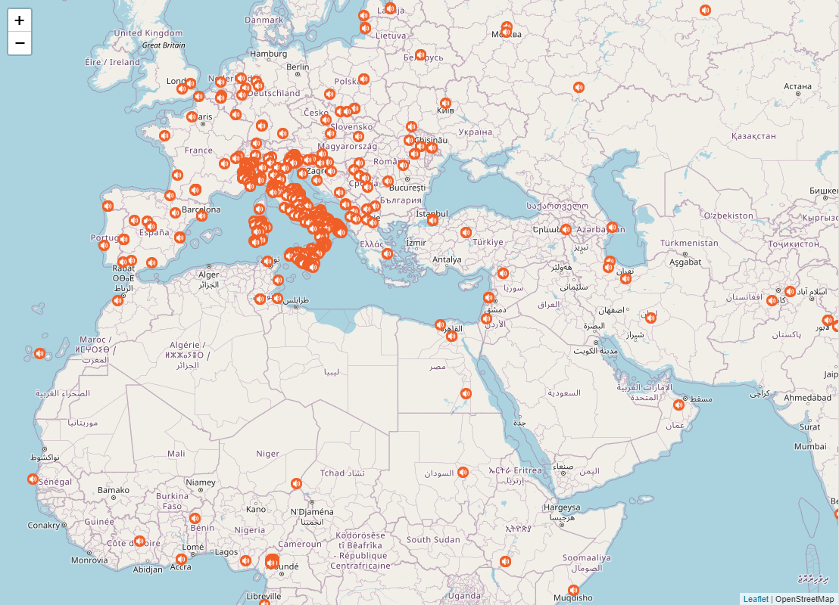
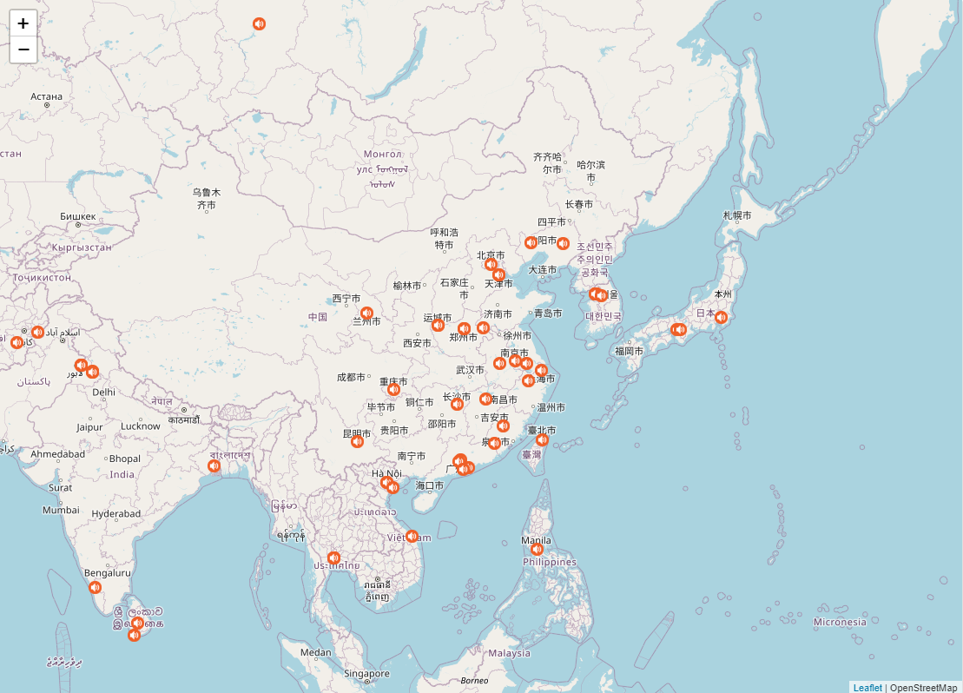
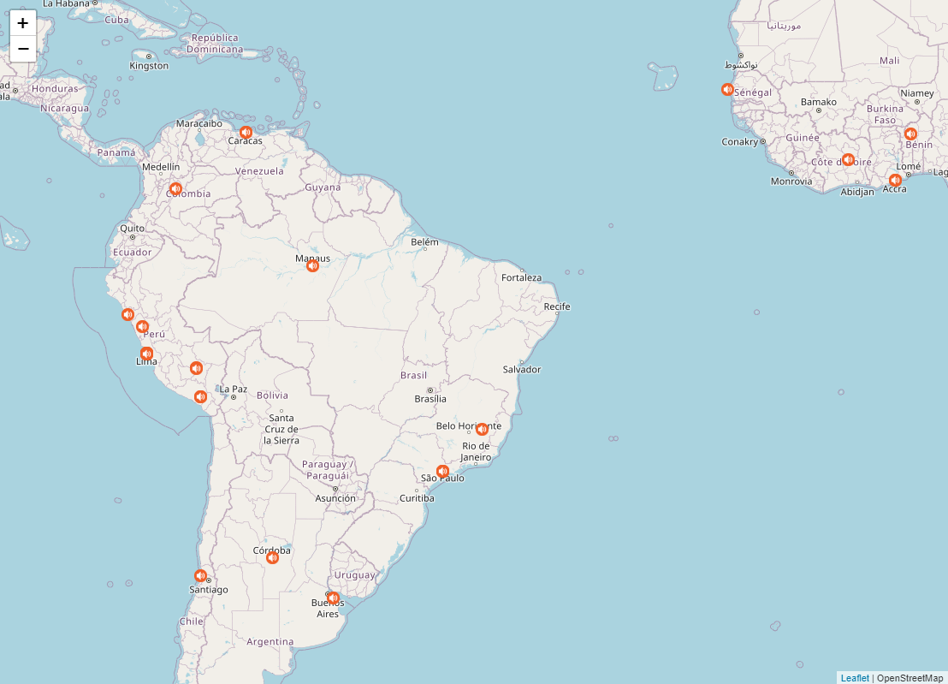
Sound and Voice archives
WALS – World Atlas of Language Structures
Ethnologue
Glottolog / Pangloss
IPA Illustrations
Clarin network
LFSAG Collection (languages and dialects)
https://www.lfsag.unito.it/ark/trm_map.html

Slide 6
The LFSAG sound archive (650 samples)
https://www.lfsag.unito.it/ark/trm_map.html

Slide 7
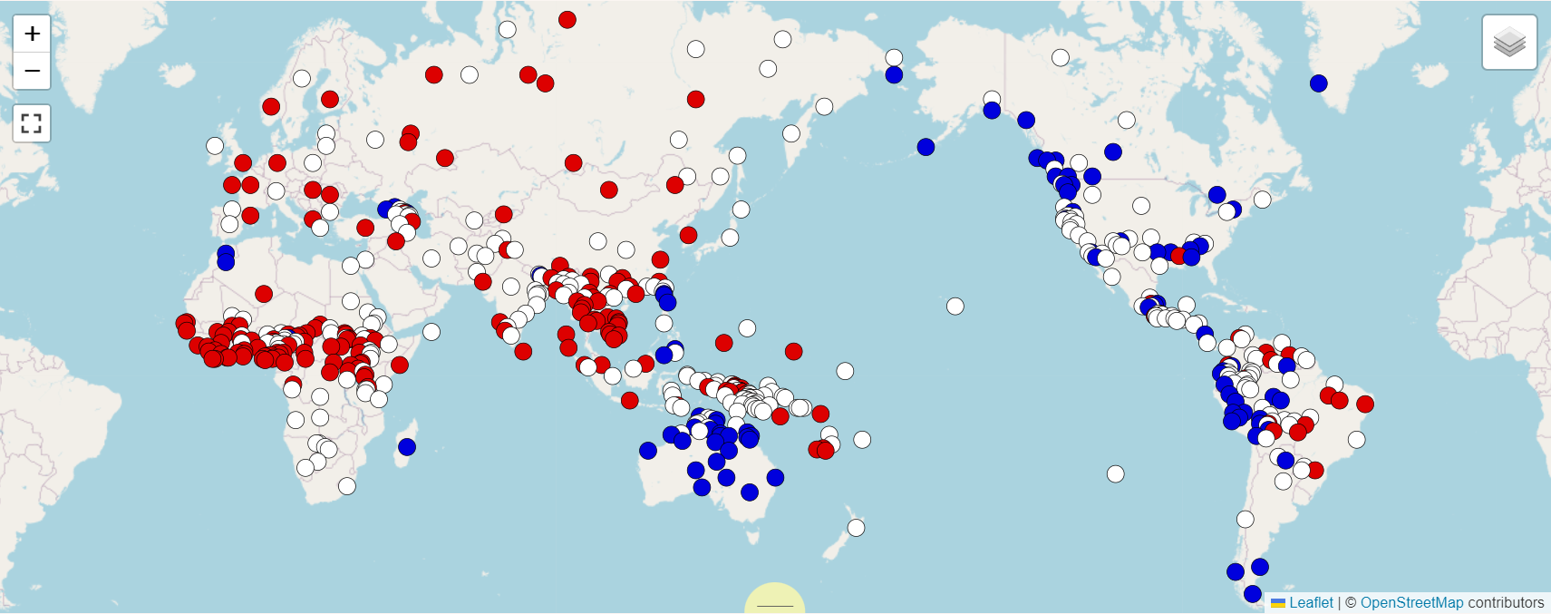
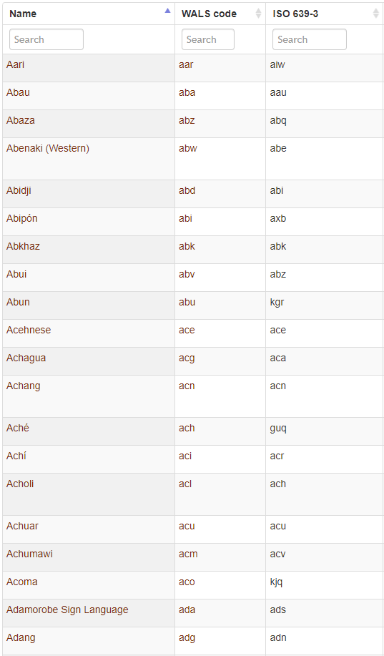
Experimental Studies
Different levels of analysis
Different models
Leipzig Glossing Rules
Indonesian (Sneddon 1996:237)
Mereka di Jakarta sekarang.
they in Jakarta now.
‘They are in Jakarta now.’
E.A.G.L.E.S. (Expert Advisory Group on Language Engineering Standards)

Slide 8
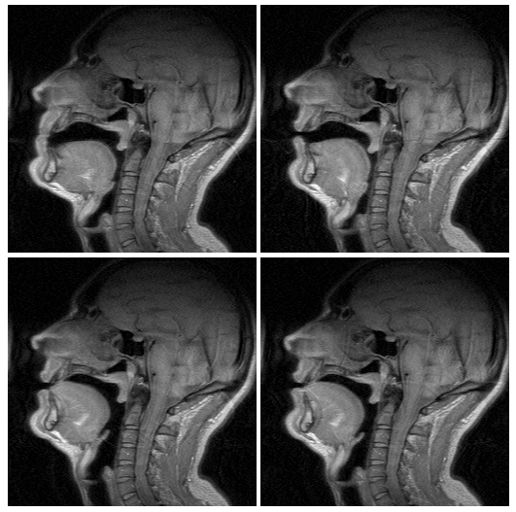
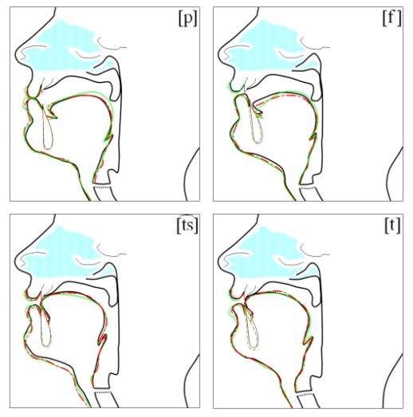
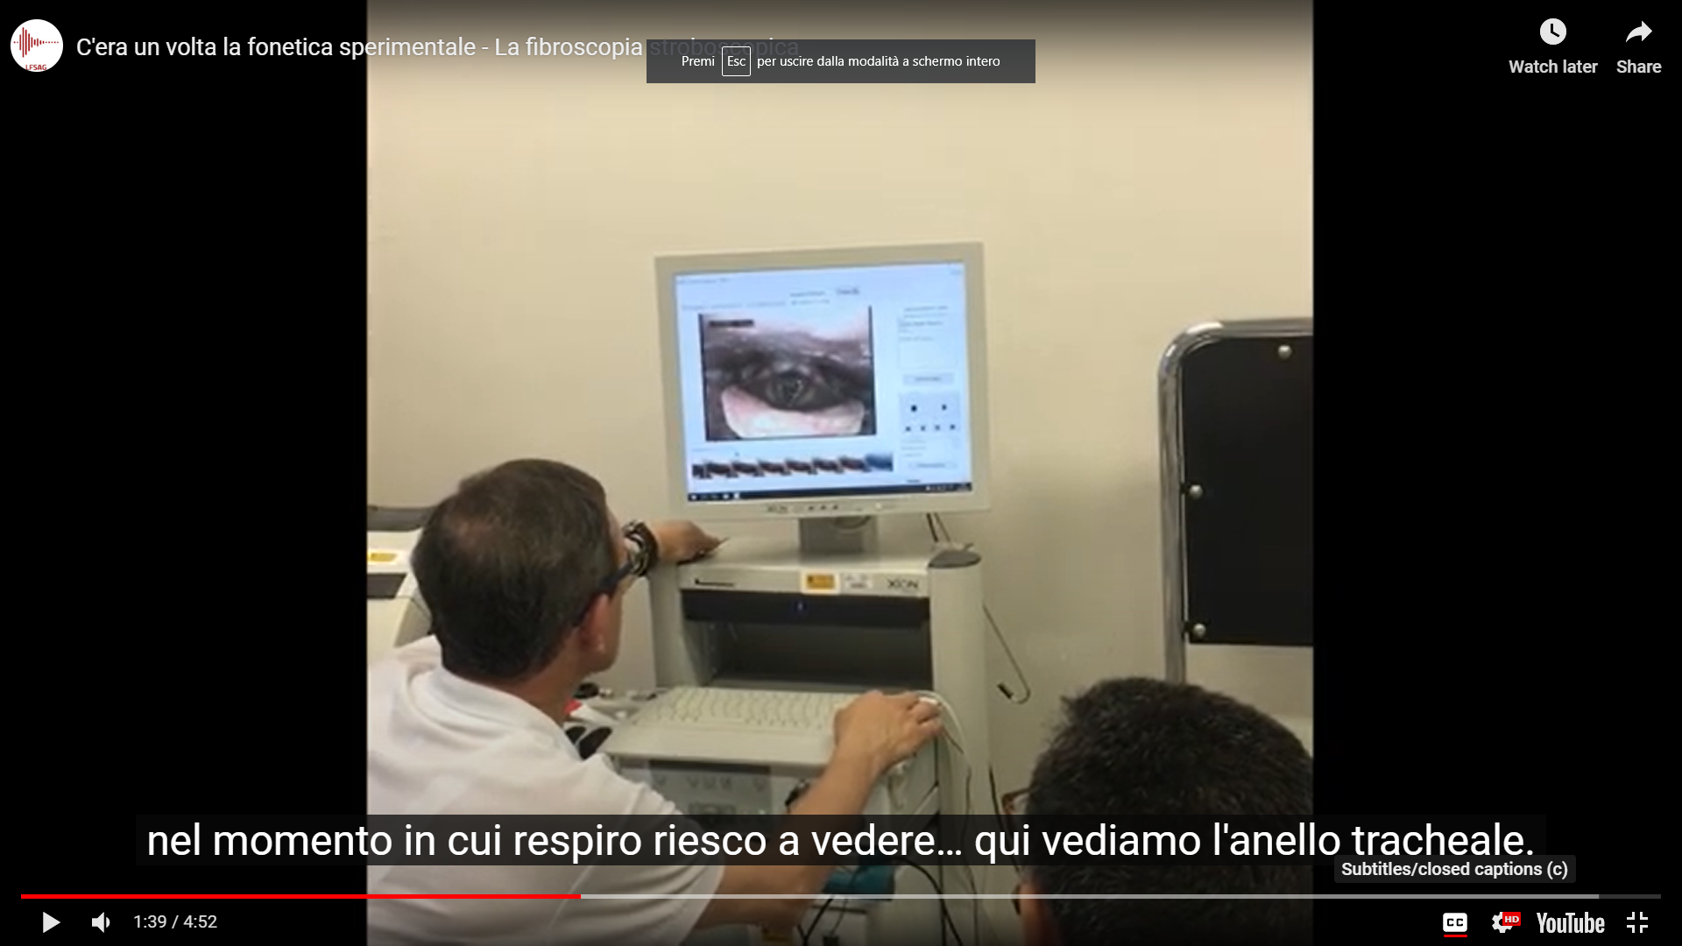
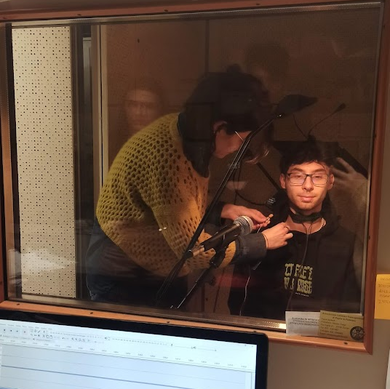
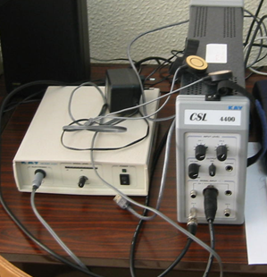
Experimental Studies
Fiberoptic laryngoscopy, EGG
MRI, UTI, Palatography
https://www.lfsag.unito.it/mri/mris.html

Slide 9
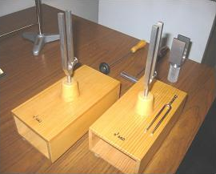
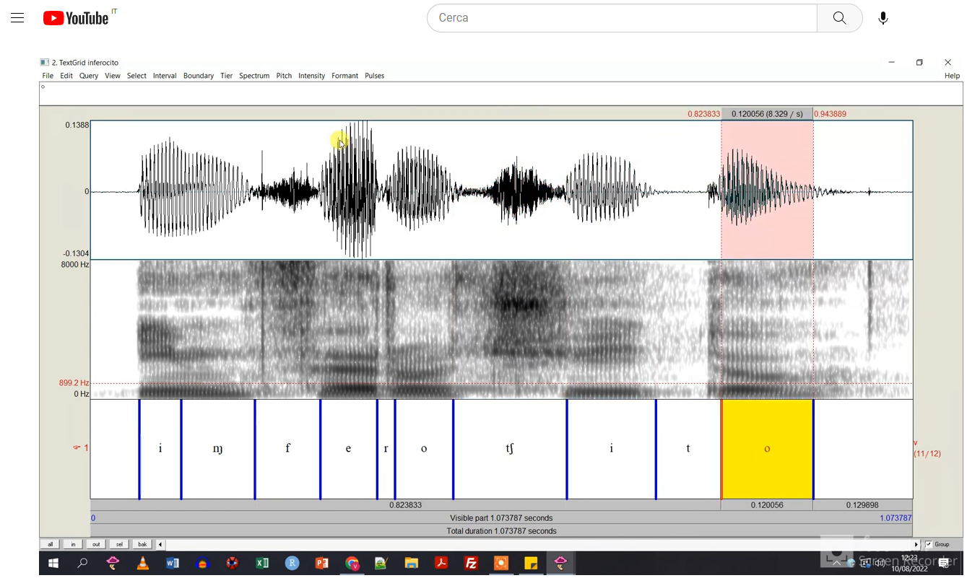
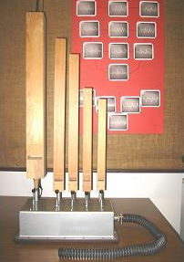
Experimental Studies
https://www.youtube.com/watch?v=ifMWH4rC18E

Slide 10
Linguistics and social media
https://www.instagram.com/lfsag_

Slide 11
Contacts
Laboratorio di Fonetica Sperimentale “Arturo Genre”
Università degli Studi di Torino
Antonio Romano
antonio.romano@unito.it
https://www.lfsag.unito.it - lfsag.unito@gmail.com

